Slide 1

University of Technology (yatanarpon cyber city)
Myanmar Character Recognition from Documents using Convolutional Neural Network
Supervised
by
Dr. May Thu Win
Presented by
Ma Khin Khant Khant Hlaing
ME(IST) - 16
8.1.2020
Defense

Slide 2
Outline
Abstract
Objectives
Introduction
System Design
System Overview
Result
Conclusion
Limitations
Further Extension
Publication

Slide 3
Abstract
In Myanmar, there are the huge amount of paper documents in the offices that are needed to digitize and store information available in that paper documents.
It is a demand to automatically recognize texts from that paper documents and to store information.
Optical Character Recognition (OCR) is a process of converting an image, such as handwritten files, scanned document or electronic fax, into machine-editable format.
Some usage of the OCR system : Document Conversion, Signature Verification and Identification, Text to Speech, Online Search
The system is to convert the data available on printed papers written in Myanmar language into computer editable documents.

Slide 4

Objectives
To develop a Myanmar character recognition system to perform Document Editing
To support in managing papers in the offices that are needed to digitize
To apply Convolutional Neural Networks in classification process of OCR
To be cost effective and save time consuming

Slide 5
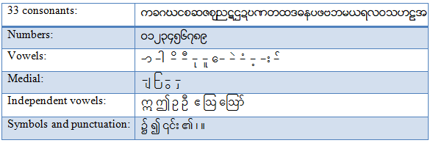
Introduction
Character recognition is one of the important applications of pattern recognition.
Although there has been a significant number of improvements in languages such as English, but recognition of Myanmar scripts is in little effort.
The Myanmar script developed from the Mon script and more than (32) million people use Myanmar script.
Figure 1. A set of Myanmar Alphabet

Slide 6
Cont’d
The system is implemented to recognize Myanmar characters from document images using Convolutional Neural Network (CNN).
CNN has been successfully applied to many problems.
CNN uses relatively little pre-processing compared to other image classification algorithms.
The advantage of CNN is that it automatically extracts the salient features.

Slide 7
System Design
Training Phase
START
START
Testing Phase
Document Image
Document Image
Preprocessing
- Line localization
- Binarization
- Noise Elimination
- Skew Detection
Preprocessing
- Binarization
- Noise Elimination
- Skew Detection
Segmentation
- Line Segmentation
- Character Segmentation
Segmentation
- Line Segmentation
- Character Segmentation
Trained Data Set
Training with CNN
Recognition with CNN
END
Trained Model
Myanmar Unicode text
END
Figure 2. System Design of the Myanmar OCR

Slide 8
System Overview
Image acquisition is the first phase in any image processing or pattern recognition task.
In this system, the document image, in tiff, jpg, bmp, and png format is captured using a IR-3245N scanner.
Preprocessing
After obtaining the digital image, the next step is to apply preprocessing to improve the image clarity and also the accuracy of recognition rates.
Preprocessing involves various stages for smoothing, enhancing, filtering, etc. to improve and enhance image quality.

Slide 9
Cont’d
As preprocessing, firstly we detect the text lines.
Line Localization
This work means removing logo and complex background.
We detect the regions by using the saturation in place of intensity and process regions to conform to area and saturation thresholds.
And delete those regions that don’t pass qualifications for image.

Slide 10
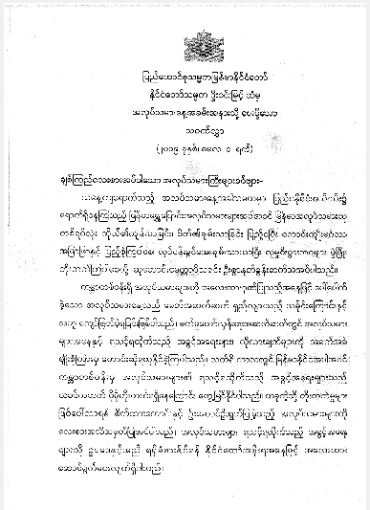
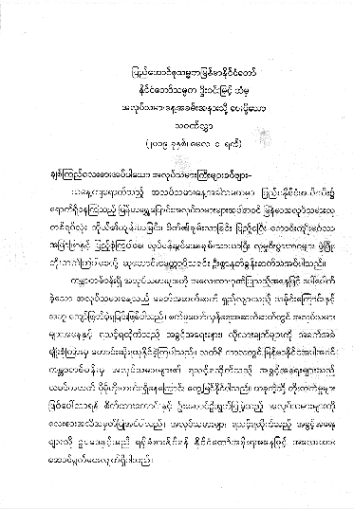
Figure 3. Original Color Image
Figure 4. Image after Line Localization

Slide 11
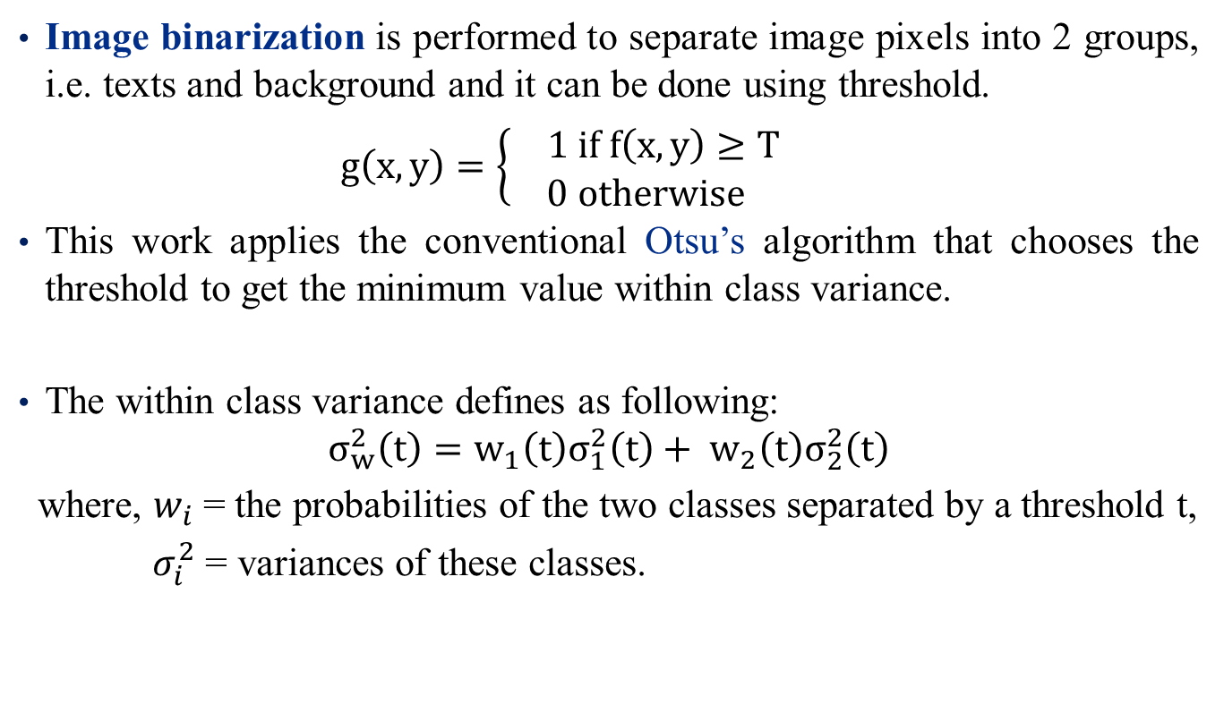
Cont’d
Image binarization is performed to separate image pixels into 2 groups, i.e. texts and background and it can be done using threshold.
$g\left(x,y\right)=\left\{\begin{aligned} 1 if f\left(x, y\right)≥T \\ 0 otherwise\end{aligned}\right.$
This work applies the conventional Otsu’s algorithm that chooses the threshold to get the minimum value within class variance.
The within class variance defines as following:
$$σ_{w}^{2}\left(t\right)=w_{1}\left(t\right)σ_{1}^{2}\left(t\right)+ w_{2}\left(t\right)σ_{2}^{2}\left(t\right)$$
where, $w_{i}$ = the probabilities of the two classes separated by a threshold t,
$σ_{i}^{2}$ = variances of these classes.

Slide 12
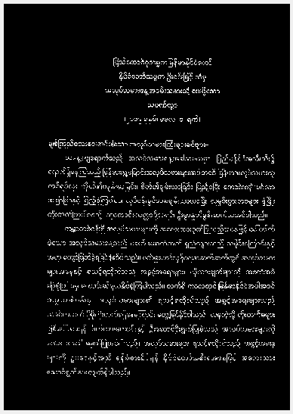
Figure 5. Image after Binarization

Slide 13
Cont’d
Noise that exists in images is one of the major obstacles in pattern recognition tasks and decreases the readability of text from images.
For salt and pepper noise, median filter is used.
The median filtering process is accomplished by sliding a window over the image.
The filtered image is obtained by placing the median of the values in the input window, at the location of the center of that window, at the output image.

Slide 14
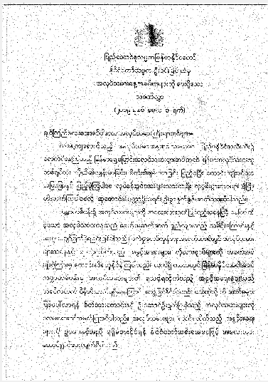
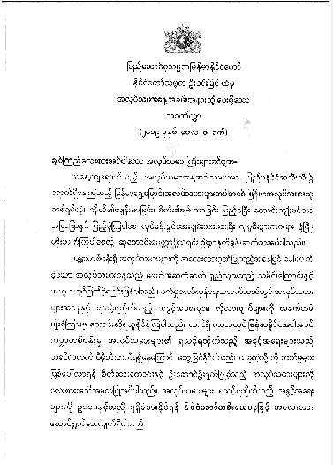
Figure 6. Image with Noise
Figure 7. Image after Noise Elimination

Slide 15
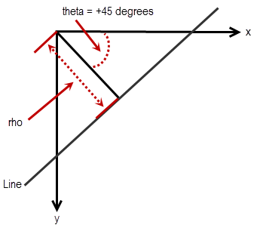
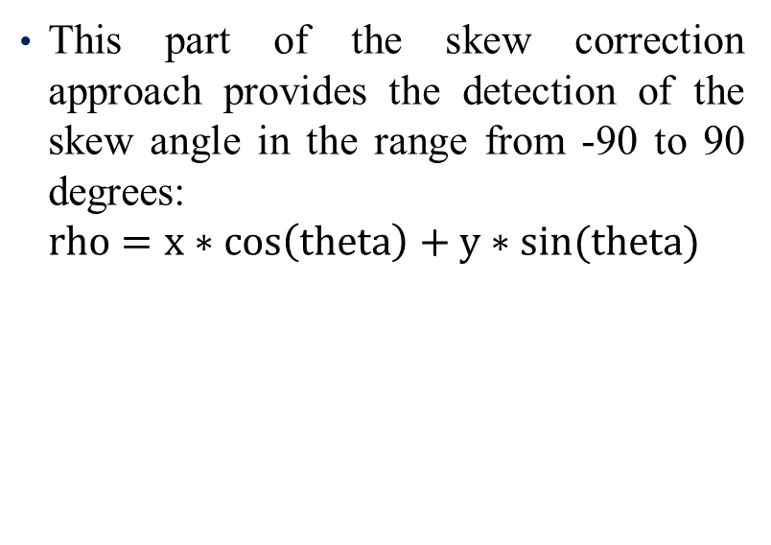
Cont’d
Skewed images directly impact the line segmentation of OCR engine which reduces its accuracy.
Hough transform is performed on the scanned document image for skew detection and the variance in ρ values is calculated for each value of θ.
This part of the skew correction approach provides the detection of the skew angle in the range from -90 to 90 degrees:
$$rho=x∗\cos\left(theta\right)+y∗sin(theta)$$
Figure 8. Skew Angle Calculation

Slide 16
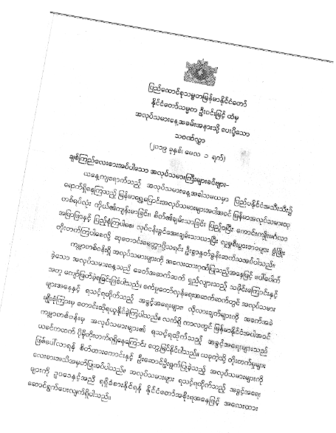
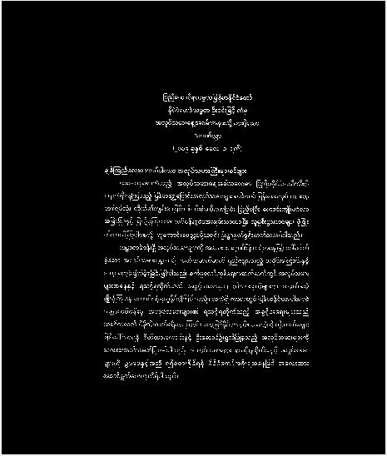
Figure 9. Skewed Image
Figure 10. Image after De-skew

Slide 17
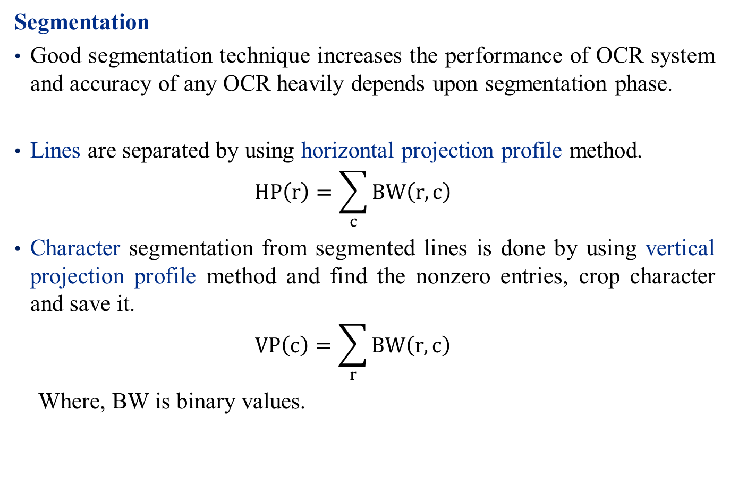
Cont’d
Segmentation
Good segmentation technique increases the performance of OCR system and accuracy of any OCR heavily depends upon segmentation phase.
Lines are separated by using horizontal projection profile method.
$$HP\left(r\right)=\sum_{c}{BW\left(r,c\right)}$$
Character segmentation from segmented lines is done by using vertical projection profile method and find the nonzero entries, crop character and save it.
$$VP\left(c\right)=\sum_{r}{BW\left(r,c\right)}$$
Where, BW is binary values.

Slide 18
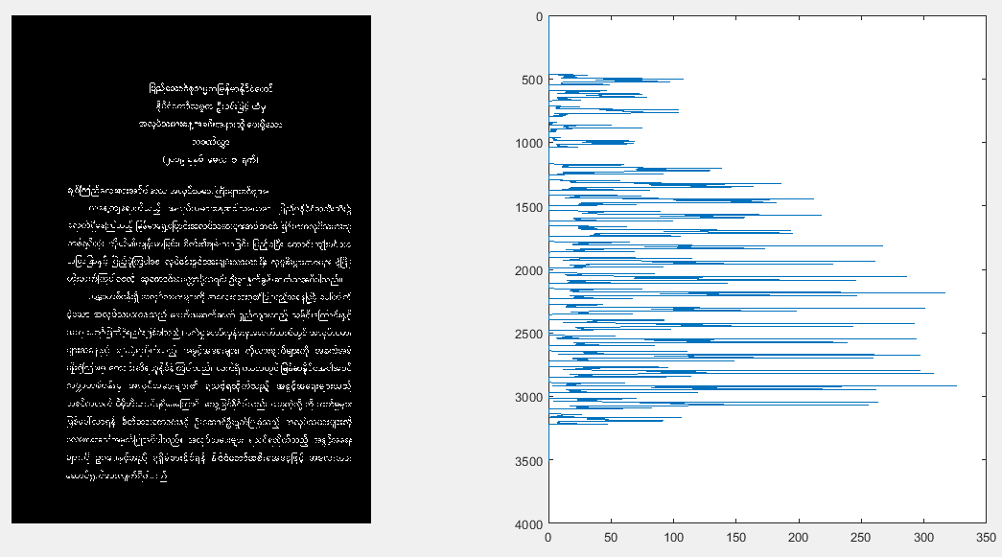
Figure 11. Horizontal Projection for line Segmentation

Slide 19
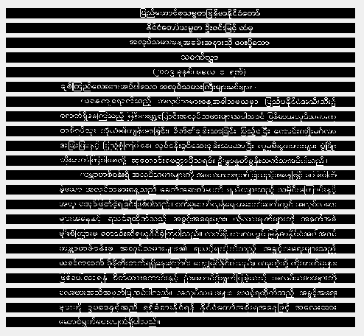
Figure 12. Segmented Lines

Slide 20
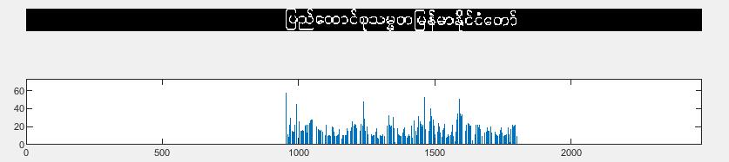
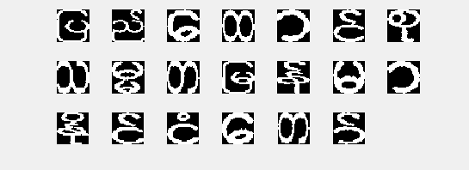
Figure 13. Vertical Projection for Character Segmentation of the First Line
Figure 14. Segmented Characters of the First Line

Slide 21
Cont’d
Character Recognition
Recognition is performed by using the pre-trained Convolutional Neural Network (CNN).
CNNs are deep artificial neural networks that are used primarily to classify images, cluster them by similarity, and perform object recognition within scenes.
There are four main operations in CNN :
Convolution
Non Linearity (ReLU)
Pooling or Sub Sampling
Classification (Fully Connected Layer)

Slide 22
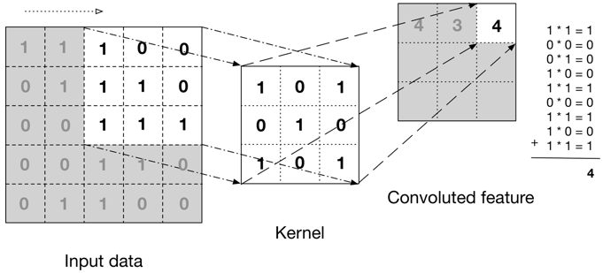
Cont’d
Convolution Step
To extract features from the input image.
The more number of filters we have, the more image features get extracted and the better our network becomes at recognizing patterns in unseen images.
Figure 15. Example of a convolution operation

Slide 23
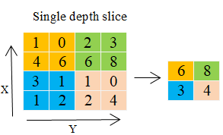
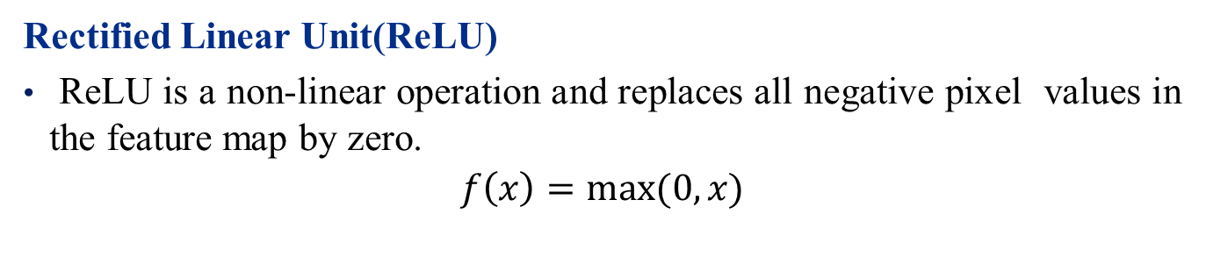
Cont’d
Rectified Linear Unit(ReLU)
ReLU is a non-linear operation and replaces all negative pixel values in the feature map by zero.
$$f\left(x\right)=max⁡(0,x)$$
Pooling or Subsampling
Pooling reduces the dimensionality of each feature map but retains the most important information.
Spatial Pooling can be of different types: Max, Average, Sum etc.
Figure 16. Max pooling with 2x2 filter and stride = 2

Slide 24
Cont’d
Classification (Fully Connected layer)
The Fully Connected layer is a traditional Multi Layer Perceptron that uses a softmax activation function in the output layer.
It connects every neuron in one layer to every neuron in another layer.
The purpose of this layer is to use features of Conv and Pooling for classifying the input image into various classes based on the training dataset.

Slide 25

Fully Connection
Conv3
(3x3) kernel
Conv2
(3x3) kernel
Max-pool3 (2x2)
Output
Max-pool2 (2x2)
Conv1
(3x3) kernel
Max-pool1 (2x2)
The CNN architecture for Myanmar printed character recognition

Slide 26
Cont’d
This architecture is used for both training and testing the Myanmar Character recognition.
Input Layer - (32x32x1) image
Three convolutional layers with n1=64, n2=128, and n3=256 filters respectively
Batch normalization layer between Conv layer and ReLU
Max Pooling after each ReLU layer
FC (i.e. fully-connected) layer with a softmax activation function in the output layer

Slide 27





























Cont’d
Compound words
CNN Training
We trained the CNN for total 583 classes :
Consonants = 33 classes ,
Digits = 10 classes, and
Compound words like – “က်”, “ကျ”, “ကာ”, “ကုံ” = 540classes
Total images = 43725
For each character recognition, we use:
Input Size = 32x32
Training data = 60 images
Testing data = 15 images
Font size = 12, 14, 16, 20, 24
Consonants and digit

Slide 28
Cont’d
Finally, the recognized characters are converted into Unicode and saved in a text file.
For example, there is one of the complexities of implementing Myanmar script in Unicode:
​ေန 1014 1031 the sun
ေပါ 1015 1031 102B plentiful
ကျောင်း 1000 103B 1031 102C 1004 103A 1038 school
န
ေ
ပ
ေ
ါ
က
ျ
ေ
ာ
င
း
််

Slide 29
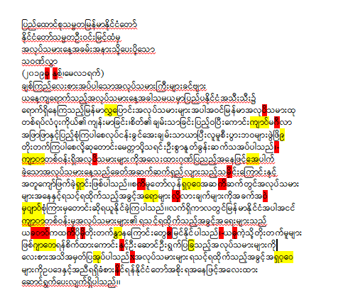
Figure 17. Recognized text

Slide 30
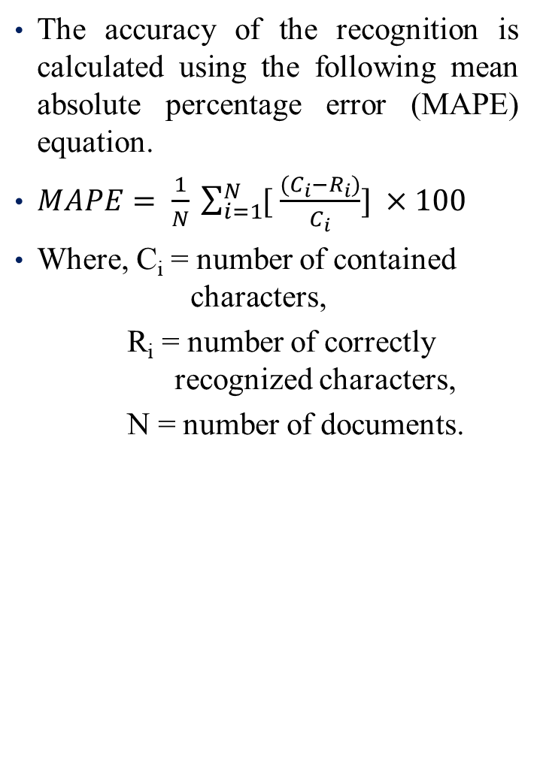
Result
Table I
Accuracy of character recognition for font size 12 and 14
The accuracy of the recognition is calculated using the following mean absolute percentage error (MAPE) equation.
$MAPE= \frac{1}{N} \sum_{i=1}^{N}{[ \frac{(C_{i}−R_{i})}{C_{i}}]} ×100$
Where, C_{i} = number of contained characters,
R_{i} = number of correctly recognized characters,
N = number of documents.
Document No. | Font Size | Correctly Recognized Characters | Total Characters | Accuracy (%)
1 | 12 | 465 | 505 | 92.08
 | 14 | 457 | 505 | 90.50
2 | 12 | 377 | 432 | 87.27
 | 14 | 361 | 432 | 83.56
3 | 12 | 608 | 644 | 94.41
 | 14 | 613 | 644 | 95.19
4 | 12 | 697 | 750 | 92.93
 | 14 | 670 | 718 | 93.31
5 | 12 | 513 | 546 | 93.96
 | 14 | 495 | 546 | 90.66
6 | 12 | 741 | 785 | 94.39
 | 14 | 722 | 785 | 91.97
7 | 12 | 828 | 868 | 95.39
 | 14 | 812 | 868 | 93.54
8 | 12 | 306 | 351 | 87.18
 | 14 | 310 | 351 | 88.32
9 | 12 | 643 | 709 | 90.69
 | 14 | 651 | 709 | 91.82
10 | 12 | 392 | 434 | 90.32
 | 14 | 391 | 434 | 90.09
Average Accuracy |  |  |  | 91.38

Slide 31
Table II
Accuracy of character recognition
Document No. | Number of contained characters | Number of correctly recognized characters | Accuracy
1 | 768 | 719 | 93.62%
2 | 491 | 439 | 89.41%
3 | 798 | 742 | 92.98%
4 | 651 | 603 | 92.63%
5 | 756 | 700 | 92.59%
6 | 592 | 545 | 92.06%
7 | 422 | 402 | 95.26%
8 | 649 | 549 | 84.59%
9 | 548 | 440 | 80.29%
10 | 534 | 470 | 88.01%
11 | 447 | 416 | 93.06%
12 | 612 | 542 | 88.56%
13 | 617 | 556 | 90.11%
14 | 799 | 722 | 90.36%
15 | 698 | 595 | 85.24%
16 | 780 | 666 | 85.38%
17 | 968 | 856 | 87.81%
18 | 433 | 397 | 91.69%
19 | 453 | 388 | 85.65%
20 | 660 | 558 | 84.55%

Slide 32
Document No. | Number of contained characters | Number of correctly recognized characters | Accuracy
21 | 811 | 741 | 91.36%
22 | 714 | 673 | 94.26%
23 | 562 | 83 | 85.23%
24 | 843 | 738 | 87.54%
25 | 549 | 494 | 89.98%
26 | 531 | 485 | 91.34%
27 | 174 | 136 | 78.16%
38 | 609 | 574 | 94.25%
39 | 636 | 577 | 90.72%
30 | 417 | 371 | 88.97%
31 | 419 | 381 | 90.93%
32 | 450 | 413 | 91.77%
33 | 396 | 384 | 96.97%
34 | 373 | 354 | 94.91%
35 | 476 | 453 | 95.17%
36 | 345 | 332 | 96.23%
37 | 773 | 720 | 93.14%
38 | 503 | 462 | 91.85%
39 | 448 | 386 | 86.16%
40 | 259 | 211 | 81.47%
Average accuracy |  | 89.85%

Slide 33
Table III. Accuracy of Character Recognition with Myanmar2 and Myanmar3
Document No. | Number of contained characters | Number of correctly recognized characters | Accuracy
1 | 399 | 300 | 75.19%
2 | 434 | 329 | 75.80%
3 | 428 | 233 | 54.43%
4 | 570 | 436 | 76.49%
5 | 415 | 281 | 67.71%
6 | 400 | 338 | 84.50%
7 | 461 | 365 | 79.17%
8 | 363 | 253 | 69.69%
9 | 577 | 425 | 73.65%
10 | 473 | 389 | 82.24%
11 | 666 | 487 | 73.12%
12 | 391 | 290 | 74.16%
13 | 436 | 316 | 72.47%
14 | 525 | 376 | 71.61%
15 | 722 | 504 | 69.80%
16 | 471 | 335 | 71.12%
17 | 448 | 318 | 70.98%
18 | 437 | 289 | 66.13%
19 | 417 | 301 | 72.18%
20 | 457 | 335 | 73.30%
Average Accuracy |  |  | 72.68%

Slide 34














Table IV
Accuracy of character recognition for three font sizes
 | Myanmar3
Font Size | 12 | 16 | 20
Correctly Recognized Characters | 644 | 652 | 362
Total Characters | 664 | 664 | 370
Accuracy | 96.99% | 98.14% | 97.84%
Accuracy of OCR heavily depends upon segmentation phase.
The most incorrect segmentation is found when the character connects to the next character.
The recognition also fails for the characters which have close resemblance.

Slide 35
Table IV
Accuracy of Character Recognition on the Documents captured by Phone
Document No. | Number of contained characters | Number of correctly recognized characters | Accuracy
1 | 350 | 329 | 94.00%
2 | 181 | 139 | 76.80%
3 | 419 | 371 | 88.54%
4 | 454 | 417 | 91.85%
5 | 634 | 567 | 89.43%
6 | 601 | 543 | 90.35%
7 | 578 | 521 | 90.14%
8 | 446 | 369 | 82.74%
9 | 347 | 321 | 92.51%
10 | 257 | 208 | 80.93%
11 | 449 | 376 | 83.74%
12 | 706 | 645 | 91.36%
13 | 487 | 436 | 89.53%
14 | 765 | 700 | 91.50%
15 | 410 | 355 | 86.59%
Average Accuracy |  |  | 81.80%

Slide 36

Conclusion
OCR system for Myanmar characters which are commonly used in offices’ paper works is presented.
The training dataset of Myanmar character images are prepared and trained by using the CNN.
In the testing, preprocessing is performed on the input image to enhance and clean, and then segmentation is performed to extract each character for recognition.
The recognition is done by using the pre-trained CNN.
According to the experiments, the accuracy is around 89.85%

Slide 37
Limitations
This system cannot get the good results if the original source image itself is blurring and has poor resolution.
This system cannot support for handwritten characters.
The number of recognized characters is limited to 583 characters.

Slide 38
Further Extension
According to the experiments, mis-recognition is occurred when characters in the image are not correctly segmented.
The recognition also fails for the characters which have close resemblance.
The character correction can be a solution to the mis-recognized characters.
This can be done by deploying higher level contextual information such as text correction using semantic text information.

Slide 39
Publication
Khin Khant Khant Hlaing, May Thu Win, “Preprocessing and Segmentation Approach for Myanmar Character Recognition on Office Document Images”, National Conference on Science and Engineering, Mandalay (NCSE2019).
Khin Khant Khant Hlaing, May Thu Win: “Myanmar Character Recognition from Documents using Convolutional Neural Network”, Joint International Conference on Science, Technology and Innovation, Mandalay by IEEE (IcSTI2019).

Slide 40
Thank you

